Slide 1




Sell Lightning fast with 'Guided Selling'
Mohammed Rizwan
Senior Salesforce Developer
Standav Digital

Slide 2
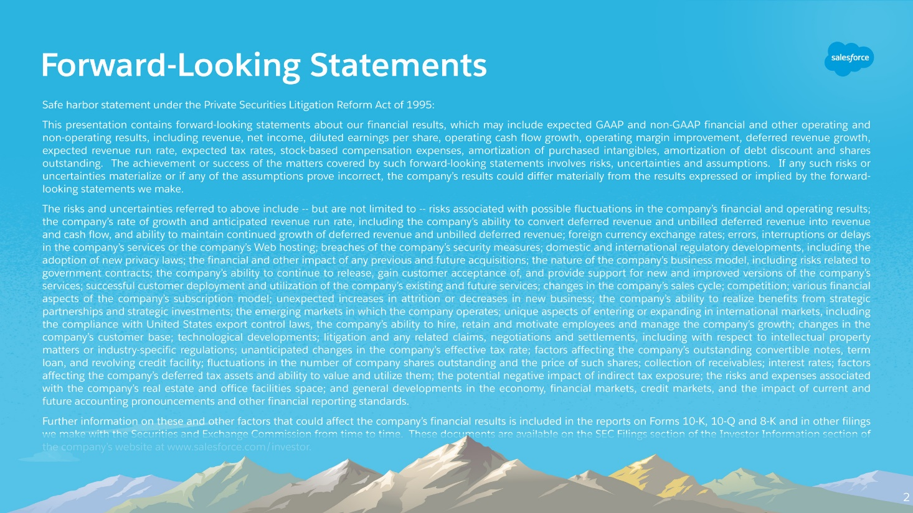

Slide 3
Agenda
Use Case
Building Blocks
Code Sample
Demo
Q&A

Slide 4
Use Case
Its vital for an org to ensure that each Sales rep knows what to do and how to do in order to ensure consistency in Sales effort
Sales reps can have various degrees of experience
Moreover, they also work with clients in multiple countries having different rules and regulations
Remembering selling strategies and ensuring compliance for different regions becomes extremely difficult

Slide 5
Building Blocks
Custom Object(s)
Custom Metadata
Apex Classes
Lightning Components
Test Classes

Slide 6
Code Sample

Slide 7
Demo

Slide 8



Q&A
For more info:
@rizwanakhtar08
/mritizi/IndiaDreamIn18
contact@mdrizwan.com

Slide 9


